Slide 1
Chapter6 (Lecture1)
Structuring System Requirements: Process Modeling

Slide 2
Use-Case Diagrams
When analyzing CBISs, we use Use-Case diagrams to help us collect the requirements for the CBISs.
Notes:
laypeople’s الناس العاديين/العامة

Slide 3
Use-Case Diagrams
What is Use-Case Diagram?
* It is a diagram that provides the high-level view of the system and convey the requirements in laypeople's terms for the stakeholders.
* A use-case diagram is a set of use cases
Notes:
laypeople’s الناس العاديين/العامة

Slide 4
Use-Case Diagrams (Cont.)
A use case is a model of the interaction between external users of a software product (actors) and the software product itself.
More precisely, an actor is a user playing a specific role.
Describing a set of user scenarios.
Capturing user requirements.
Contract between end user and software developers.
Notes:
laypeople’s الناس العاديين/العامة

Slide 5
Use Cases
Use case diagrams describe what a system does from the standpoint of an external observer. The emphasis is on what a system does rather than how.
Use case diagrams are closely connected to scenarios. A scenario is an example of what happens when someone interacts with the system.

Slide 6
Use Case Diagram for A Library System
Use Case
Boundary
Actor
Library System
Borrow
Employee
Client
Order Title
Fine Remittance
Supervisor

Slide 7
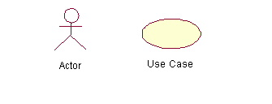
Use-Case Diagrams
Actors: A role that a user plays with respect to the system, including human users and other systems.
Use case: A set of scenarios that describing an interaction between a user and a system, including alternatives.
System boundary: rectangle diagram representing the boundary between the actors and the system.

Slide 8
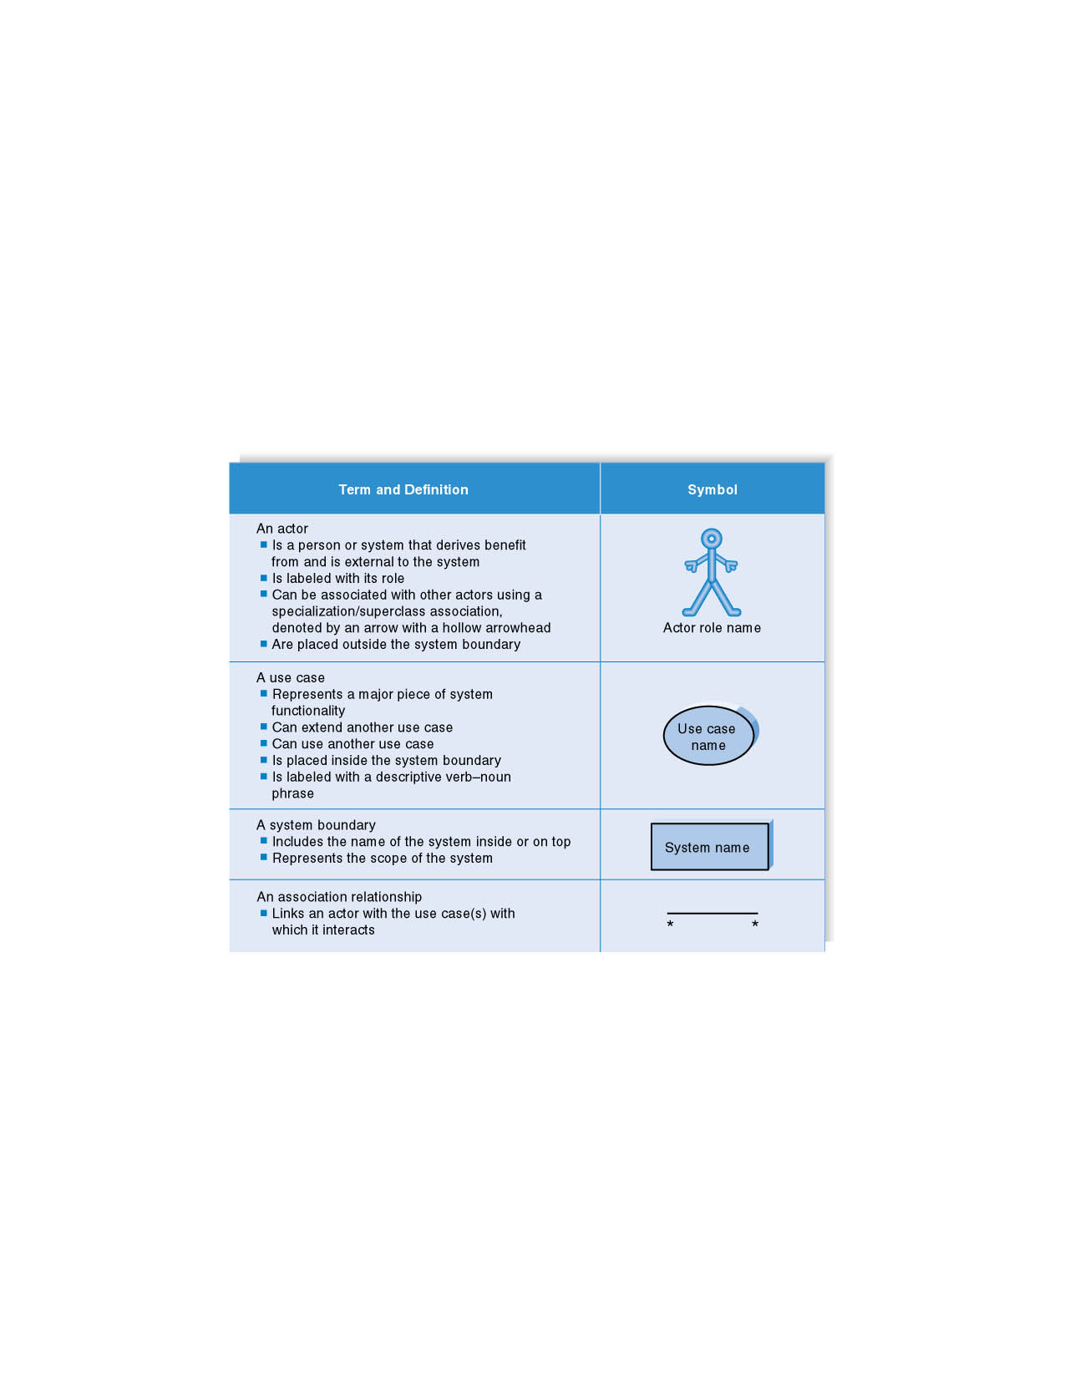
Syntax for Use Case Diagram

Slide 9
Use Cases
What is a Use Case
  A formal way of representing how a business system interacts with its environment
  Illustrates the activities that are performed by the users of the system
  A scenario-based technique in the UML
  A sequence of actions a system performs that yields a valuable result for a particular actor.

Slide 10
Use Case Diagram - Use Case
A major process performed by the system that benefits an actor(s) in some way
Models a dialogue between an actor and the system
Represents the functionality provided by the system
Notes:
Use Case
Represent the user functionality (not system functionality)

Slide 11
Use Case
Each use case in a use case diagram describes one and only one function in which users interact with the system
  May contain several “paths” that a user can take while interacting with the system
  Each path is referred to as a scenario
Notes:
Use Case
In reading a use case, you should not be able to tell if an activity is computerized or manual
Used to document the current system (AS-IS system) or the new system being developed (TO-BE system)
Communicates at a high level what the system needs to do
Captures the typical interaction of the system with the system’s users
Logical model
Physical details are defined during the design phase

Slide 12
Use Case Analysis
What is an Actor?
  A user or outside system that interacts with the system being designed in order to obtain some value from that interaction
Use Cases? describe scenarios that describe the interaction between users of the system (the actor) and the system itself.

Slide 13
Use Cases
Here is a scenario for a medical clinic.
A patient calls the clinic to make an appointment for a yearly checkup. The receptionist finds the nearest empty time slot in the appointment book and schedules the appointment for that time slot. "
We want to write a use case for this scenario.
Remember: A use case is a summary of scenarios for a single task or goal.

Slide 14
Use Cases
Step 1 Identify the actors
As we read the scenario, define those people or systems that are going to interact with the scenario.
A patient calls the clinic to make an appointment for a yearly checkup. The receptionist finds the nearest empty time slot in the appointment book and schedules the appointment for that time slot. "

Slide 15
Questions for Identifying People Actors
Who is interested in the scenario/system?
Where in the organization is the scenario/system be used?
Who will benefit from the use of the scenario/system?
Who will supply the scenario/system with this information, use this information, and remove this information?
Does one person play several different roles?
Do several people play the same role?
Notes:
Actors
7) Does one person play several different roles?
May have an actor for each role
8) Do several people play the same role?
Only use one actor per role (no matter how many people play that role)
Identifying actors is an iterative process
Defining how an actor interacts with the system may clarify whether there are duplicate actors or not

Slide 16
Questions for Identifying Other Actors
What other entity is interested in the scenario/system?
What other entity will supply the scenario/system with this information, use this information, and remove this information?
Does the system use an external resource?
Does the system interact with a legacy system?
Notes:
Actors
7) Does one person play several different roles?
May have an actor for each role
8) Do several people play the same role?
Only use one actor per role (no matter how many people play that role)
Identifying actors is an iterative process
Defining how an actor interacts with the system may clarify whether there are duplicate actors or not

Slide 17
Actors
An Actor is outside or external the system.
It can be a:
  Human
  Peripheral device (hardware)
  External system or subsystem
  Time or time-based event
Represented by stick figure
Notes:
Actors
Are NOT a part of the system (external to the system)
A single actor may represent multiple physical users
Whether human or not, represented by stick figure
MUST label stick figure with the name of the actor

Slide 18
Use Cases
An actor is who or what initiates the events involved in the task of the use case. Actors are simply roles that people, or objects play.
So as we read our scenario, what or who is the actor????

Slide 19

Use Case - Actor
Labelled using a descriptive noun or phrase
Represented by a stick character
Notes:
Actors: An actor portrays any entity (or entities) that performs certain roles in a given system. The different roles the actor represents are the actual business roles of users in a given system. An actor in a use case diagram interacts with a use case. For example, for modeling a banking application, a customer entity represents an actor in the application. Similarly, the person who provides service at the counter is also an actor. But it is up to you to consider what actors make an impact on the functionality that you want to model. If an entity does not affect a certain piece of functionality that you are modeling, it makes no sense to represent it as an actor. An actor is shown as a stick figure in a use case diagram depicted "outside" the system boundary, as shown in Make Appointment figure.
Depicted by an oval
MUST label the oval with the name of the use case
To identify an actor, search in the problem statement for business terms that portray roles in the system. For example, in the statement "patients visit the doctor in the clinic for medical tests," "doctor" and "patients" are the business roles and can be easily identified as actors in the system.

Slide 20
Use Cases
So as we read our scenario, what or who is the actor????
A patient calls the clinic to make an appointment for a yearly checkup. The receptionist finds the nearest empty time slot in the appointment book and schedules the appointment for that time slot. "
The actor is a Patient.

Slide 21
Use Cases
The use case is a summary of scenarios for a single task or goal.
So What is the Use Case????
The Use Case is Make Appointment.
It is a use case for the medical clinic.

Slide 22
Use Case
Labelled using a descriptive verb-noun phrase
Represented by an oval
Make
Appointment
Notes:
Use case: A use case in a use case diagram is a visual representation of a distinct business functionality in a system. The key term here is "distinct business functionality." To choose a business process as a likely candidate for modeling as a use case, you need to ensure that the business process is discrete in nature. As the first step in identifying use cases, you should list the discrete business functions in your problem statement. Each of these business functions can be classified as a potential use case. Remember that identifying use cases is a discovery rather than a creation. As business functionality becomes clearer, the underlying use cases become more easily evident. A use case is shown as an ellipse in a use case diagram Depicted by an oval
MUST label the oval with the name of the use case

Slide 23
Use Case Components
The use case has three components.
The use case task referred to as the use case that represents a feature needed in a software system.
The actor(s) who trigger the use case to activate.
The communication line to show how the actors communicate with the use case.

Slide 24
Use Case - Relationships
Relationships
  Represent communication between actor and use case
  Depicted by line or double-headed arrow line
  Also called association relationship
Make
Appointment
Notes:
Use Case Relationship
Association relationship
May exist between actor and a use case
Often referred to as a communicate association
Navigable in both directions (actor to use case and use case to actor)
Some use just a line
Others use a double-headed arrowhead
Navigable in only one direction (actor to use case OR use case to actor)
Use a arrowhead where arrowhead denotes the direction of communication
Navigation direction of an association represents who is initiating the communication
Multiplicity
Not consistency shown on all use-case diagrams (Some do; some don’t)

Slide 25
Use Case - Relationships
Boundary
  A boundary rectangle is placed around the perimeter of the system to show how the actors communicate with the system.
Make
Appointment
Notes:
System boundary: A system boundary defines the scope of what a system will be. A system cannot have infinite functionality. So, it follows that use cases also need to have definitive limits defined. A system boundary of a use case diagram defines the limits of the system. The system boundary is shown as a rectangle spanning all the use cases in the system.
Other use cases in this lecture also show the system boundary of the clinic application. The use cases of this system are enclosed in a rectangle. Note that the actors in the system are outside the system boundary.
The system boundary is potentially the entire system as defined in the problem statement. But this is not always the case. For large and complex systems, each of the modules may be the system boundary. For example, for an ERP system for an organization, each of the modules such as personnel, payroll, accounting, and so forth, can form the system boundary for use cases specific to each of these business functions. The entire system can span all of these modules depicting the overall system boundary.

Slide 26

Use Cases
The picture below is a Make Appointment use case for the medical clinic.
The actor is a Patient. The connection between actor and use case is a communication association (or communication for short).
Actors are stick figures. Use cases are ovals. Communications are lines that link actors to use cases.

Slide 27
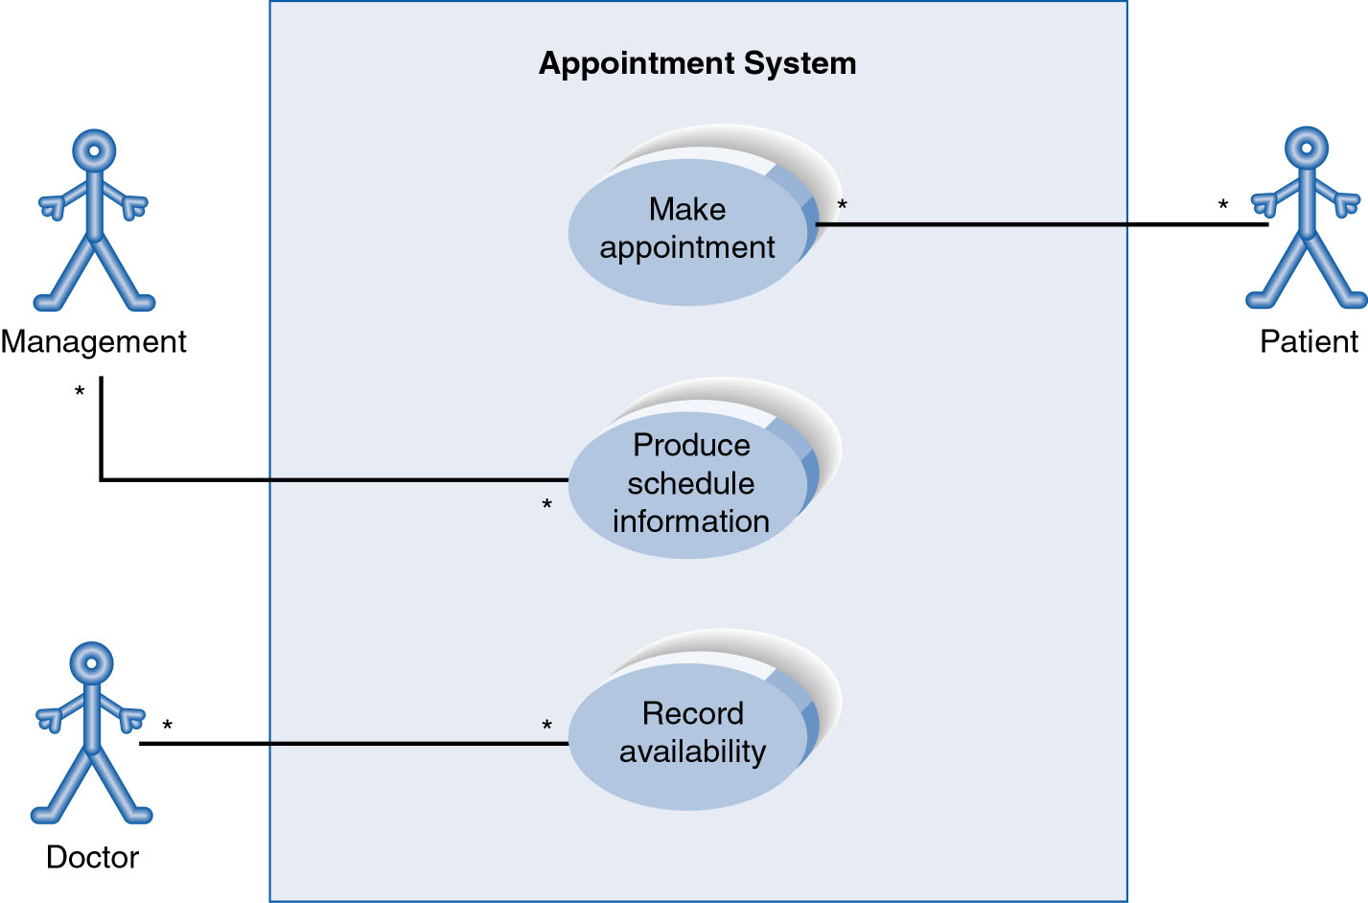
Use Case Diagram for Appointment System
A use case diagram is a collection of actors, use cases, and their communications.
Notes:
Example Use Case
ACTORS
Represented by a stick figure
named
USE CASE
Represented by an oval
Named (POORLY NAMED; should be verb phrase)
RELATIONSHIP
2-way association

Slide 28
Thank You
Notes:
5
5

Slide 29
Chapter6 (Lecture2)
Structuring System Requirements: Process Modeling

Slide 30
Use Cases
Step 1 Identify the actors
As we read the scenario, define those people or systems that are going to interact with the scenario.
A patient calls the clinic to make an appointment for a yearly checkup. The receptionist finds the nearest empty time slot in the appointment book and schedules the appointment for that time slot. "

Slide 31
Use Case Diagram for Appointment System
A use case diagram is a collection of actors, use cases, and their communications.
Notes:
Example Use Case
ACTORS
Represented by a stick figure
named
USE CASE
Represented by an oval
Named (POORLY NAMED; should be verb phrase)
RELATIONSHIP
2-way association

Slide 32
Syntax for Use Case Diagram

Slide 33
Use-Case Diagrams
Association:
communication between an actor and a use case; Represented by a solid line.
Generalization: relationship between one general use case and a special use case (used for defining special alternatives) Represented by a line with a triangular arrow head toward the parent use case.
Notes:
Association اتحاد
Generalization تعميم

Slide 34
Use Case Diagram
Other Types of Relationships for Use Cases
  Generalization
  Include
  Extend
Notes:
Inheritance

Slide 35
Components of Use Case Diagram
Generalization Relationship
  Represented by a line and a hollow arrow
    From child to parent
Child use case
Parent use case
Notes:
Inheritance
A use case generalization shows that one use case is simply a special kind of another.
A clinic may have a use case such as Pay Bill which would be a parent use case and Bill Insurance which is the child.
A child can be substituted for its parent whenever necessary.
Generalization appears as a line with a triangular arrow head toward the parent use case.

Slide 36
Use Case Diagram
Include Relationship
  Represents the inclusion of the functionality of one use case within another
  Arrow is drawn from the base use case to the used use case
  Write << include >> above arrowhead line
Notes:
Include relationship
Notice that ONLY between use cases (not between actors)
MANDATORY functional
Multiple use cases may share pieces of the same functionality
Rather than have duplicate functionality in several use cases
Put shared functionality in one use case and show relationship between it and other use cases that “uses” its functionality
Depicted by arrowhead with word “<<include>>” above it
Include relationships factor use cases into additional ones.
Includes are especially helpful when the same use case can be factored out of two different use cases.
If a clinic had a cases of Make Appointment and Request Medication.
Both might include Check Patient Record as a subtask.
Both would include a call to the use case Check Patient Record.
We don’t want to write it twice we simply want to include in as a call from both.
In the diagram,
include notation is a dotted line beginning at base use case ending with an arrows pointing to the include use case.
The dotted line is labeled <<include>>.

Slide 37
Use Case Diagram
Extend relationship
  Represents the extension of the use case to include optional functionality
  Arrow is drawn from the extension use case to the base use case
  Write << extend >> above arrowhead line
Notes:
Use Case Relationship
Extend relationship
Used to show optional behavior (behavior that is run only under certain circumstances)
Depicted by arrowhead with word “<<extend>>” above it
An extend relationship indicates that one use case is a variation of another.
This is often used when much of the same code may be in both only one extends the functionality somewhat.
A typical example is a add record to the database and modify that record.
So an add student is similar to a modify student so I may reuse some of the code.
Extend notation is a dotted line, labeled <<extend>>, and with an arrow toward the base case.
The extension point, which determines when the extended case is appropriate, is written inside the base case.

Slide 38
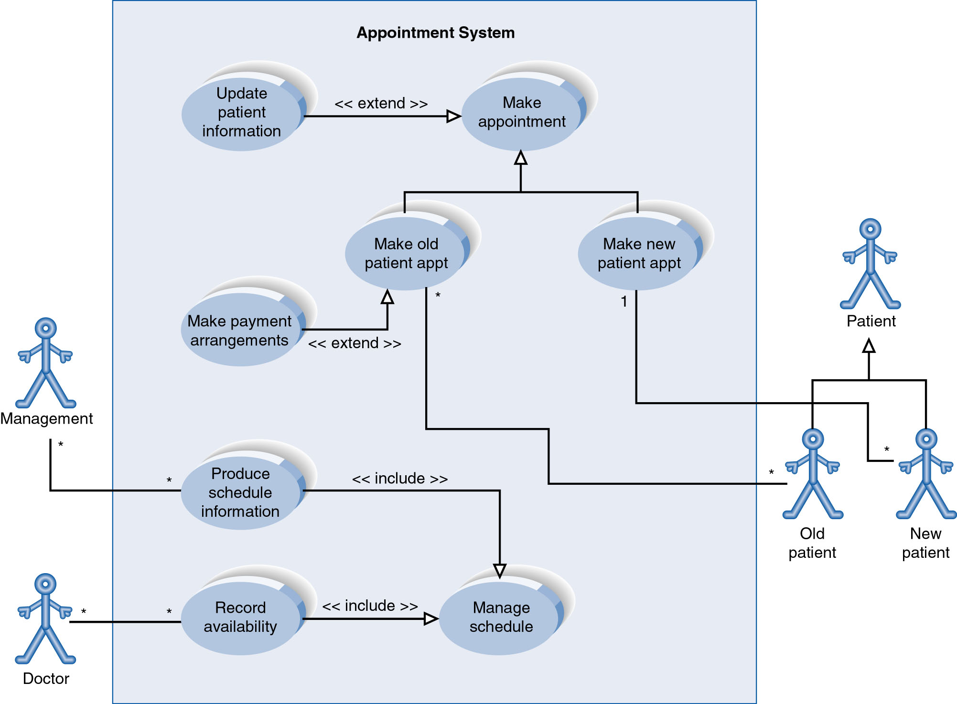
Example of Relationships
Notes:
System Boundary
Use cases are enclosed within a system boundary
a box that represents the system and clearly delineates what parts of the diagram are external or internal to it
Name of the system can appear inside or on top of the box

Slide 39
Use Case Relationships
Pro:
  Reduces redundancy in use cases
  Reduces complexity within a use case
Con
  May introduce complexity to use case diagram
Notes:
Mainly talking about extend, include, and generalization relationships.
95% of relationships on a use case diagram is association

Slide 40
Benefits of Use Cases
* Use cases are the primary vehicle for requirements capture
* Use cases are described using the language of the customer.
* Use cases provide an easily-understood communication mechanism.
* When requirements are traced, they make it difficult for requirements to fall through the cracks
* Use cases provide a concise summary of what the system should do at an abstract (low modification cost) level.
Notes:
Traced تتبع
Cracks تشقق

Slide 41
Thank You
Notes:
5
5

Slide 42
Chapter7 (Lecture1)
Structuring System Requirements: Conceptual Data Modeling

Slide 43
Lecture’s Agendas:
Entity- Relationship Model VS Entity- Relationship Diagram.
The purpose of using ER-Diagram.
Main components of ER-Diagram: Entity, Attribute, Relationship, and Cardinality.

Slide 44
Entity-Relationship Model VS Entity-Relationship Diagram.
Entity- Relationship Model:
It is a detailed, logical representation of the entities, associations and data elements for an organization or business area.
Entity-Relationship Diagram.
It is a graphical representation of an E-R model.
It is a model that identifies the concepts or entities that exist in a system and the relationships between those entities

Slide 45
The Purpose of Using ER-Diagram.
1. We determine the requirements of an information system by drawing a conceptual ERD that represents the high-level business objects/entities of the system.
2.The database analyst/designer gains a better understanding of the information to be contained in the database through the process of constructing the ERD. (Prepare the system for the next phase of SDLS which is System Design.)

Slide 46
Main Components of ER-Diagram
There are four main components of Entity-Relationship Diagram:
Entity.
Attribute.
Relationship.
Cardinality.

Slide 47
First: Entity
It is a Real-world object distinguishable from other objects.
It can be an object with a physical existence (person, house) or an object with conceptual existence (company, job, university, course).
It should be a singular noun.

Slide 48
Entity (Cont.)
Any entity can be classified in one of the following categories:
Regular Entity: any physical object, event, or abstract concept that we can record facts about. (It has a primary key.)
Weak Entity: any entity that depends on another entity for its existence. A weak entity is the entity which can't be fully identified by its own attributes and takes the foreign key as an attribute (generally it takes the primary key of the entity it is related to and it is called a foreign key).
Entity
Weak Entity

Slide 49
Second: Attribute
Each Entity has a set of Attributes
Attribute is a property or characteristic of an entity that is of interest to the organization.
Example: STUDENT: Student_ID, Student_Name, Phone_Number, Major.
An attribute name:
  Should be a noun and capitalize the first letter of each word. (Example: Student_Name.)
  Should be unique.
  Attribute names are enclosed by ovals and connected to their entities by single line.
Attribute
Attribute
Entity

Slide 50
Attribute (Cont.)
Some types of attributes:
Single Value Attribute: Attributes having single value for particular entity. Ex: Age
Multivalued Attribute: It can have more than one value at a time for an attribute. For ex., the skills of a surgeon is a multivalued attribute since a surgeon can have more than one skill. Another common example is the address field, which can have multiple values like zipcode, street address, state, etc.
Key Attribute: the attribute which uniquely identifies each entity is called key attribute. (Primary Key and Foreign Key.) It has to be underlined. Ex: Student_ID
Derived Attribute: It is an attribute whose value is calculated (derived) from other attributes. The derived attribute need not be physically stored within the database; instead, it can be derived by using an algorithm. Age can be derived from DoB.
Composite attribute: It is an attribute where the values of that attribute can be further subdivided into meaningful sub-parts." Typical examples for composite attribute are; Name – may be stored as first name, last name, middle initial

Slide 51
Attribute (Cont.)
Single Value Attribute
Derived Attribute
Multivalued Attribute
Composite Attribute
Key Attribute

Slide 52
Third: Relationship
A relationship is an association between two or several entities that is of particular interest.
It represents interactions between two or more entities.
A relationship name should Be a verb phrase, such as Is_assigned_to.
Relation

Slide 53
Relationship (Cont.)
Example: Relationship ‘WORKS-FOR’ between the entities of EMPLOYEE and DEPARTMENT associates each employee with the department for he works.
Employee
WORKS-FOR
Department

Slide 54
Relationship (Cont.)
The Degree of a Relationship
It is the number of entity types that participate in a relationship.
There are 3 common relationships:
Unary or Recursive relationship (degree one): a relationship between a one entity to itself.
Binary (degree two): a relationship between two entities.
Ternary (degree three): a relationship between three entities.

Slide 55
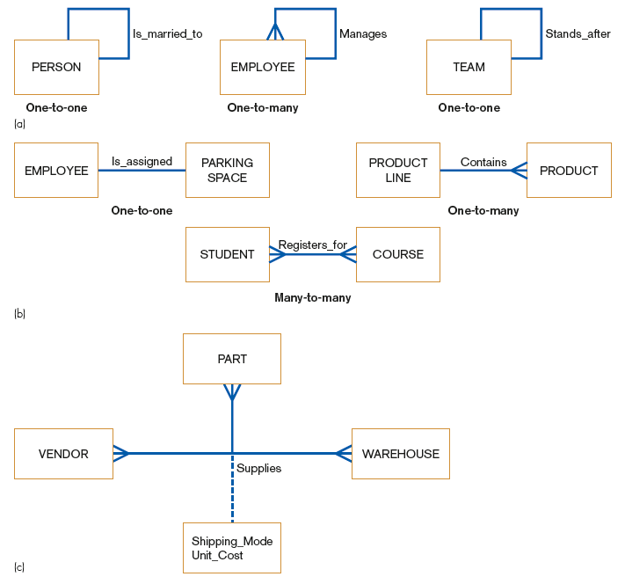
Relationship (Cont.)
Unary relationships
Examples of relationships of different degrees:
Binary relationships
Ternary relationships

Slide 56
Fourth: Cardinality
Types of Cardinalities:
One-to-one (1:1)
1
1
Man
Woman
One-to-many (1:n)
1
M
Order
Customer
Many-to-many (n:m)
M
M
Subject
Course
Cardinality: is the number of instances of entity A that can (or must) be associated with each instance of entity B
Notes:
12
12

Slide 57
Cardinality (Cont.)
Cardinality:
The number of instances of entity B that can (or must) be associated with each instance of entity A.
Minimum Cardinality:
The minimum number of instances of entity B that may be associated with each instance of entity A
Maximum Cardinality:
The maximum number of instances of entity B that may be associated with each instance of entity A
Notes:
12
12

Slide 58
Cardinality (Cont.)
The Classification of Cardinalities
Optional Cardinality:
  An Employee may or may not be assigned to a Department.
  A Patient may or may not be assigned to a Bed.
Mandatory Cardinality:
  Every Course must be taught by at least one Teacher.
  Every mother has at least a Child.

Slide 59
Cardinality (Cont.)
The Crow’s Foot Notation for ER Diagram
Mandatory 1 and only 1 cardinality
Mandatory one or many cardinality
Optional 0 or 1 cardinality
Optional zero-many cardinality

Slide 60
Cardinality (Cont.)
The Crow’s Foot Notation for ER Diagram
Employee
Manage
Department
Employee
Work_for
Department

Slide 61

Cardinality (Cont.)
The (min,max) Notation for relationship constraints

Slide 62
Thank You
Notes:
5
5

Slide 63
Chapter7 (Lecture2)
Structuring System Requirements: Conceptual Data Modeling

Slide 64
Lecture’s Agendas:
Main components of ER-Diagram: Entity, Attribute, Relationship, and Cardinality.
Steps to draw an ER- Diagram
ER- Diagram Exercise
Future classes

Slide 65
Main Components of ER-Diagram
There are four main components of Entity-Relationship Diagram:
Entity.
Attribute.
Relationship.
Cardinality.

Slide 66
Steps to Draw an ER-Diagram
Identify the entities.
Determine the attributes for each entity.
Select the primary key for each entity.
Establish the relationships between the entities.
Specify the cardinalities.
Draw an entity model.
Notes:
5
5

Slide 67
ER-Diagram Exercise
Let us consider the following problem:
In the college of Administrative Sciences at King Abdulaziz University. there are two programs which are Finance and Information Systems. Each program consists of many courses and students are enrolled in the program to pursue their bachelor’s degree. Students are main component of any academic institution and the following student information is stored: student ID, student name and student address. Students are enrolled in a program. Every program has many students, but one student can register for one program only. And, the program has a unique name. A student can take many courses and a course may be taken by many students, while each course may have zero, one or many students. The course consists of the following information: course name, course code/number, course date and time, number of students registered. Each instructor must work for one program, and each program may have one or many instructors. Every course has one or many instructors to teach that course and an instructor can teach many courses. The college keeps the following information about the instructor for any particular course he/she wants to teach: instructor number, instructor name, instructor program. Moreover, one course may have one or many sections and one section belongs to one course only. The following information is kept for section which are: section number, instructor name, section date and time.
Notes:
5
5

Slide 68
ER-Diagram Exercise (Cont.)
Now, develop an entity relationships diagram (ERD) and show entity names, primary keys, attributes for each entity, relationships between the entities and cardinality.
Notes:
5
5

Slide 69
ER-Diagram Exercise Answer
Identifying Entities, primary keys and attributes:
  Program: Program_name, Number_of_courses, Number_of_students
  Courses: Course_name, Course_code/number, Course_date_time, Number_student_ registered.
  Students: Student_ID, Student_name, Student_address
  Instructors: Instructor_number, Instructor_name, Instructor_program
  Section: Section_number, Instructor_name, Section_date_time
  Sometimes attributes are not giving, so we have to propose the appropriate attributes.
Notes:
5
5

Slide 70
ER-Diagram Exercise Answer (Cont.)
2. Establishing relationships and specifying cardinalities:
  Program --} Course: Mandatory 1:N
  Program --} Student: Mandatory 1:N
  Course --} Student: Optional N:M
  Student --} Course: Mandatory N:M
  Program --} Instructor: Mandatory 1:N
  Course --} Instructor: Mandatory N:M
  Instructor --} Course: Mandatory N:M
  Course --} Section: Mandatory 1:N
Notes:
5
5

Slide 71
ER-Diagram Exercise Answer (Cont.)
2. Establishing relationships and specifying cardinalities:
  Program --} Course: Mandatory 1:N
  Program --} Student: Mandatory 1:N
  Course --} Student: Optional N:M
  Student --} Course: Mandatory N:M
  Program --} Instructor: Mandatory 1:N
  Course --} Instructor: Mandatory N:M
  Instructor --} Course: Mandatory N:M
  Course --} Section: Mandatory 1:N
Notes:
5
5

Slide 72
Instr_number
Num_courses
Program_name
Num_students
Instr_program
Stud_ID
Instr_name
Stud_name
program
Instructor
Student
Course_name
Cour_date_time
Course_code
Stud_address
Num_stud_ reg
Course
Sec_number
Sect_date_time
Section
Instr_name
Notes:
5
5

Slide 73
ER-Diagram Exercise Answer (Cont.)
Specify relationships and cardinalities in the previous slide.
Notes:
5
5

Slide 74
Thank You
Notes:
5
5

Slide 75
Chapter7 (Lecture3)
Review on Use Case Diagram and Entity-Relationship Diagram

Slide 76
Use Case Diagram
Najran University Registration System is a registration system that provides some services to students and instructors at Najran University. The On-line NURS allows students to remotely add and remove courses, view their timetables, and view transcripts. On the other hand, instructors have their access to the system where they can view their timetables and record students’ attendance. All of these services provided by the NURS involve Registration Office, whether it is related to students or instructors.
Now, develop a Use Case diagram for the scenario mentioned above.

Slide 77
Use Case Diagram (Cont.)
Answer:

Slide 78
The Crow’s Foot Notation for ER Diagram
Employee
Manage
Department
Employee
Work_for
Department

Slide 79
ER-Diagram
1. In a specialized medical clinic, each patient must be assigned to one and only one doctor, while each doctor may have one or many patients.
Notes:
5
5

Slide 80
ER-Diagram (Cont.)
2. In a local soccer league, each team must have many players, and each player must play for one and only one team.
Notes:
5
5

Slide 81
ER-Diagram (Cont.)
3. In a rental car company, each customer may rent one car, and each car may be rented by one customer.
Notes:
5
5

Slide 82
ER-Diagram (Cont.)
4. In a school, each student must study many courses, and each course must be studied by one or many students.
Notes:
5
5

Slide 83
Thank You
Notes:
5
5

